Slide 1
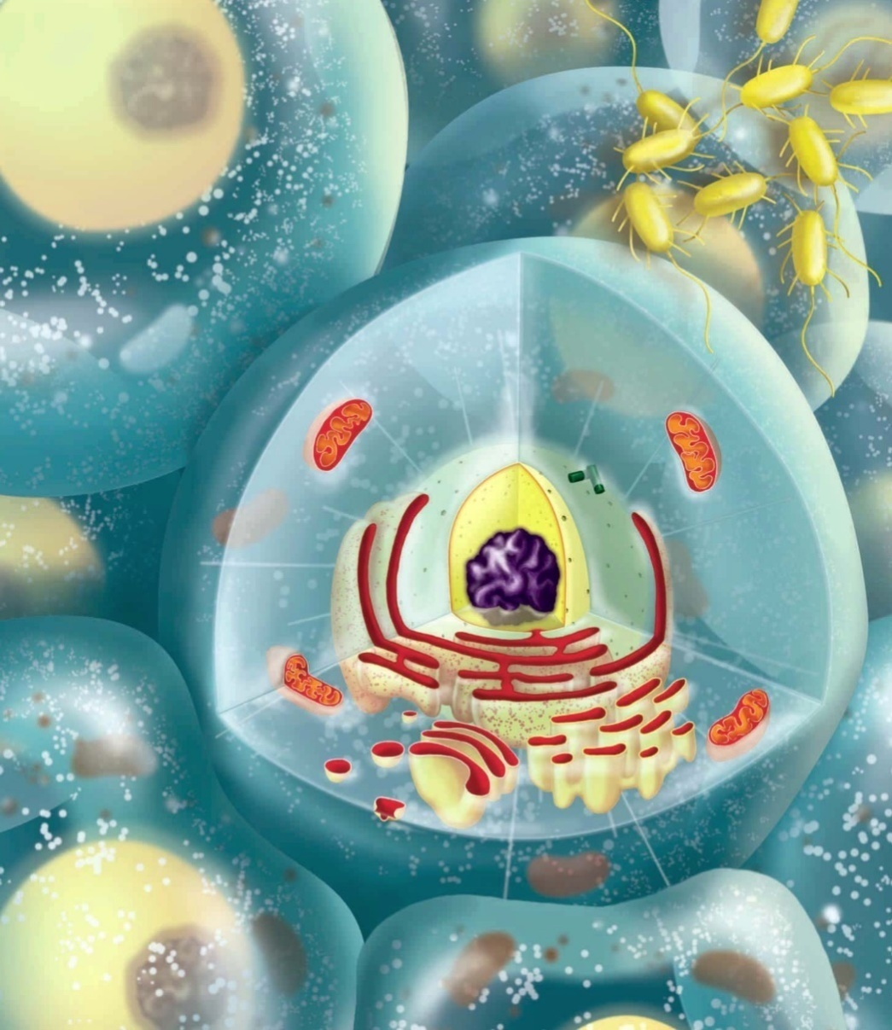
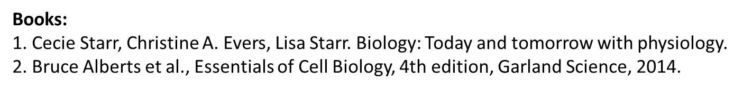
Cell Biology

Slide 2
Wondering questions on life
Questions about Life on Earth:
How did the life originate?
How stunning diversity of life produced by billions of years of evolution?
How life made home in every conceivable habitat on earth?
Questions we have about ourselves:
Where did we come from?
How do we develop from a single fertilized egg cell?
How is each of us similar to—yet different from—everyone else on Earth?
Why do we get sick, grow old, and die?

Slide 3
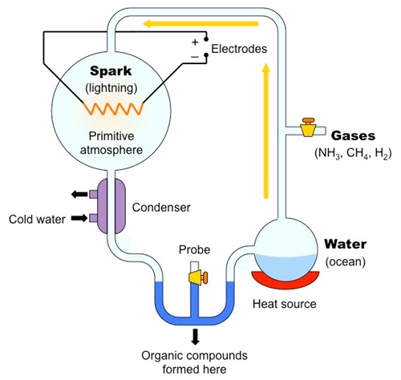
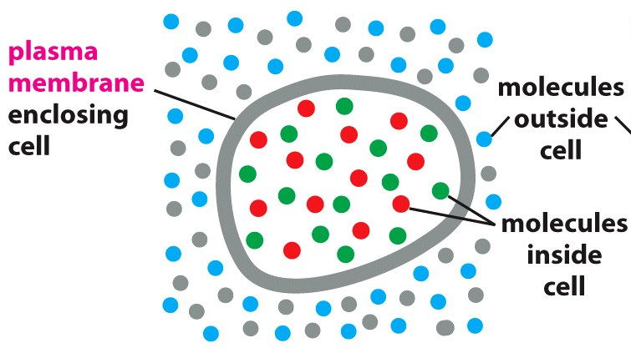
Origin of life by formation of primitive cells
In essence, any cell is simply a compartment with a watery interior that is separated from the external environment by a surface membrane (the plasma membrane) that prevents the free flow of molecules in and out of cells.
Hydrophilic
Hydrophobic
Miller–Urey experiment

Slide 4
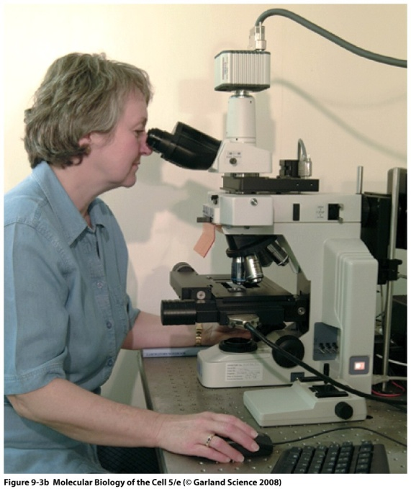
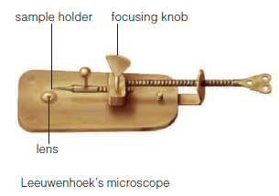
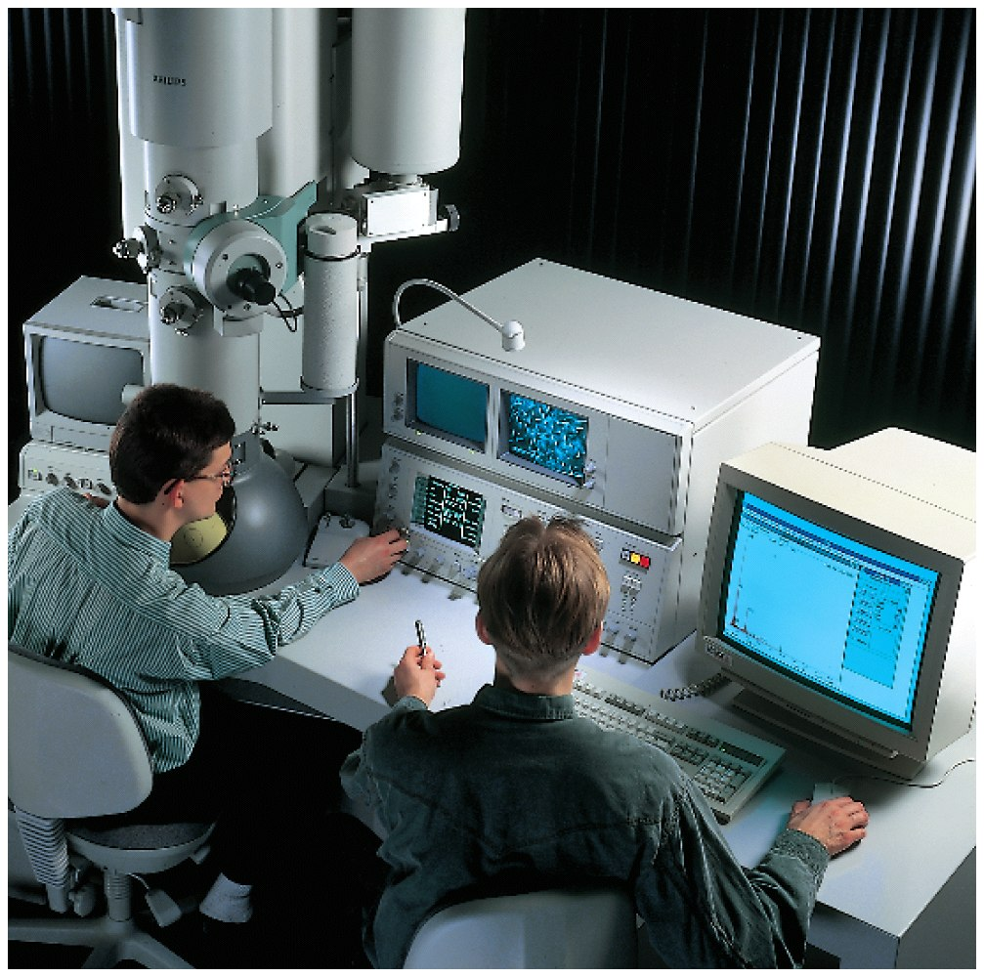
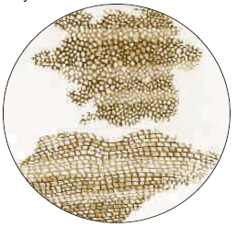
Viewing cells
Light microscope
Electron microscope
Robert Hooke’s drawing of cork

Slide 5
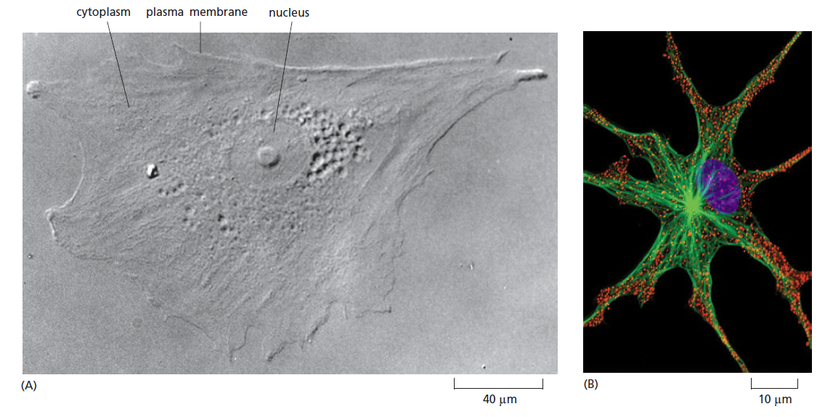
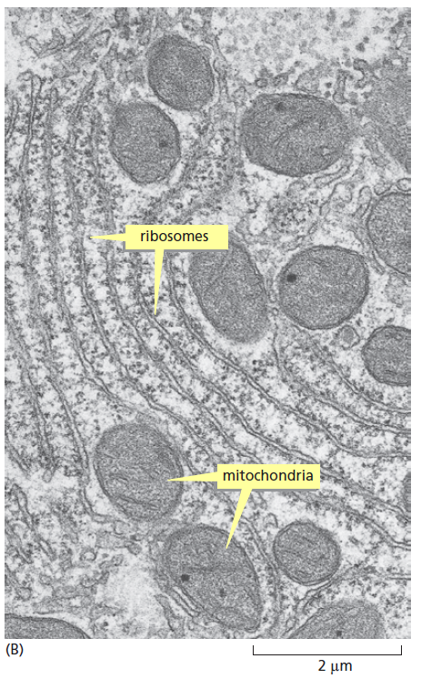
Detailed organization of a cell be visualized by Electron microscope
Light microscope
Electron microscope

Slide 6
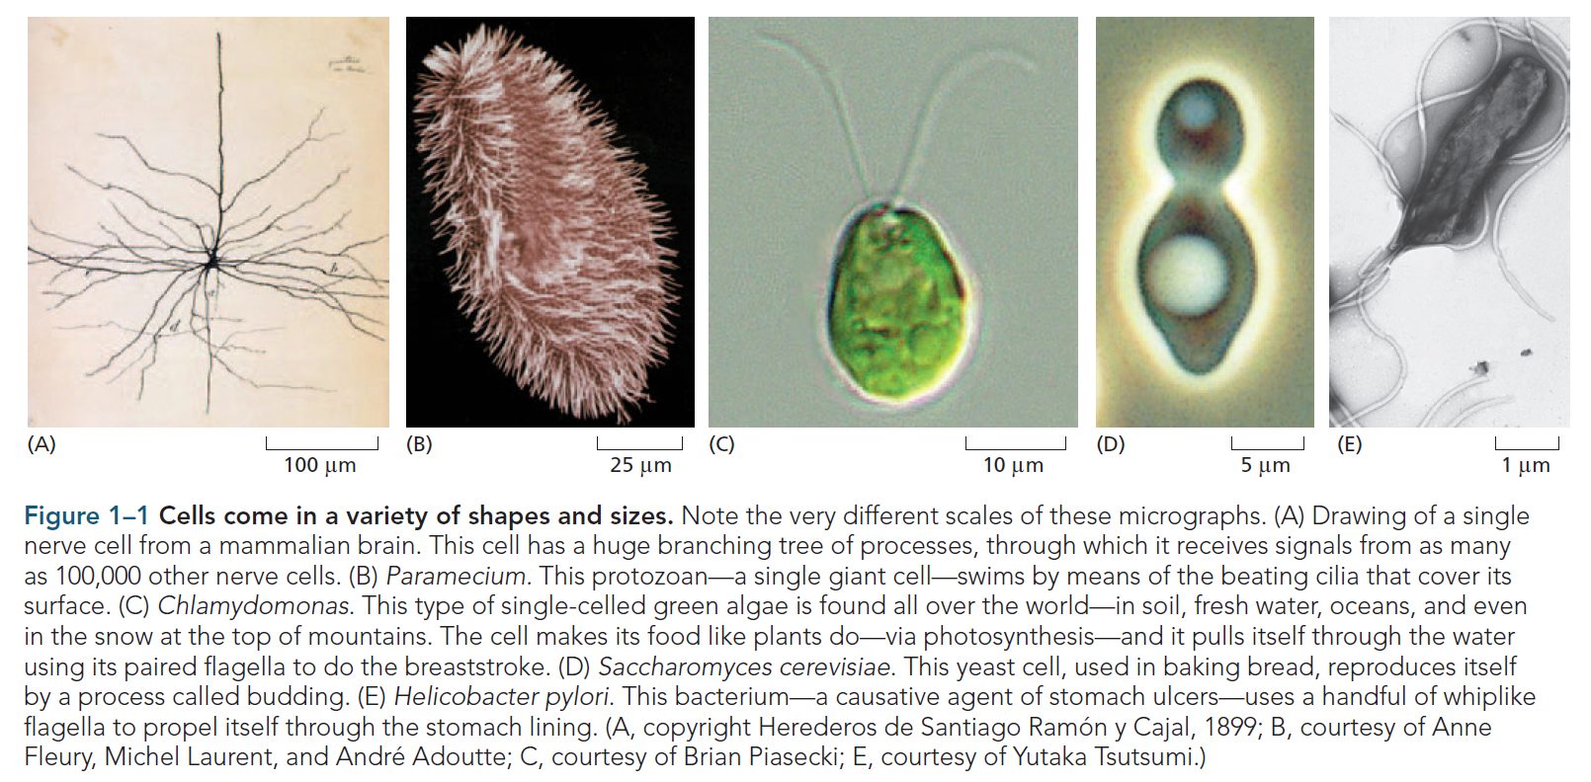
Cells vary enormously in appearance and function

Slide 7
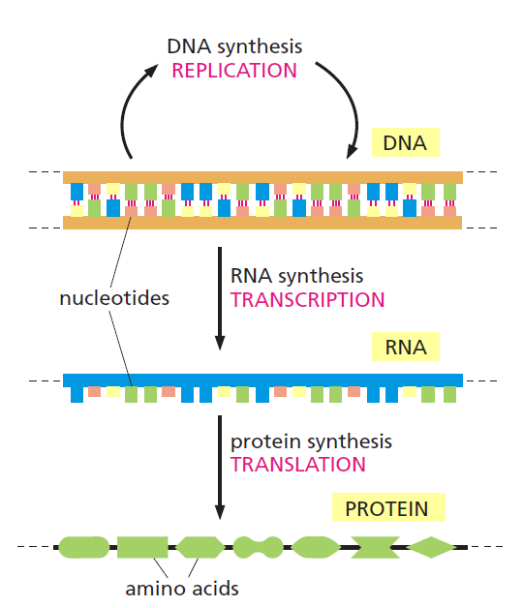
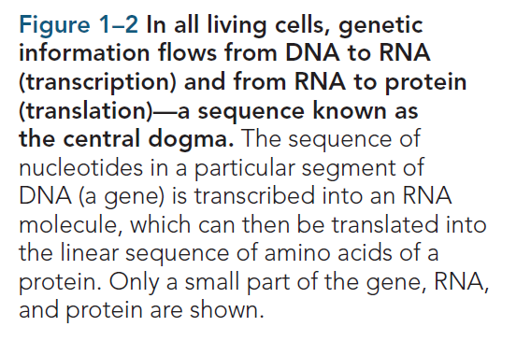
Living cells all have a similar basic chemistry
Although the cells of all living things are infinitely varied when viewed from the outside, they are fundamentally similar inside.

Slide 8
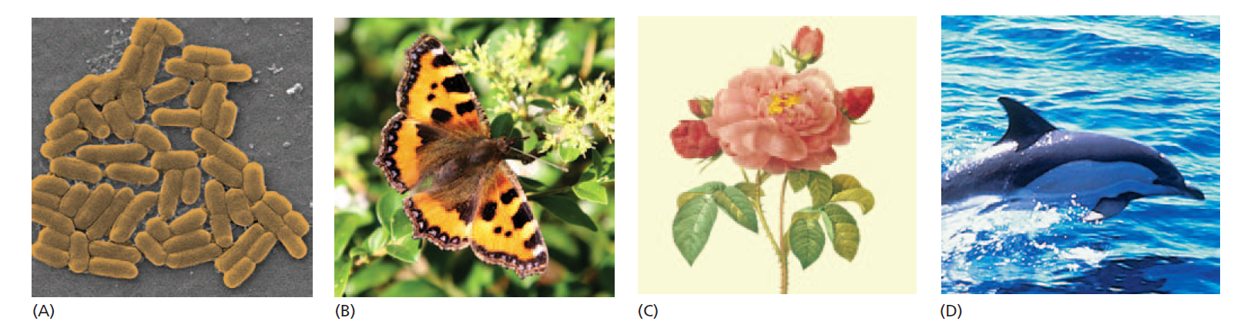
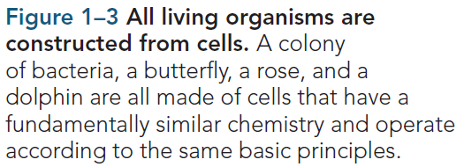
All present-day cells have apparently evolved from the same ancestral cell
A cell reproduces by replicating its DNA and then dividing in two, passing a copy of the genetic instructions encoded in its DNA to each of its daughter cells. That is why daughter cells resemble the parent cell. However, the copying is not always perfect, and the instructions are occasionally corrupted by mutations that change the DNA. For this reason, daughter cells do not always match the parent cell exactly.

Slide 9
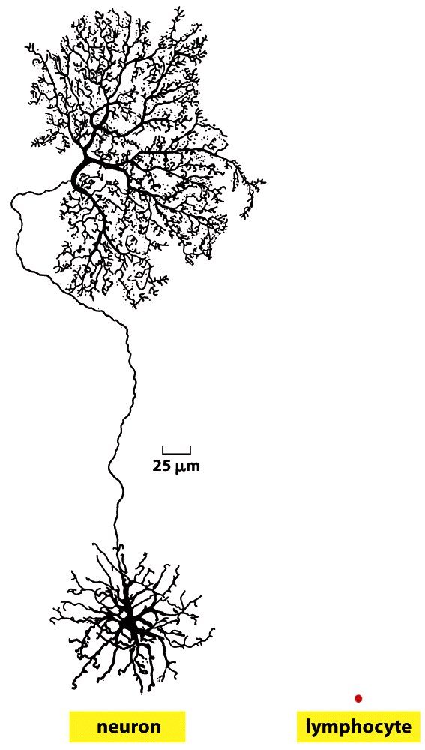
Hard to imagine these two cells originated
from same cell
All types of cell of our body originate from the zygote

Slide 10
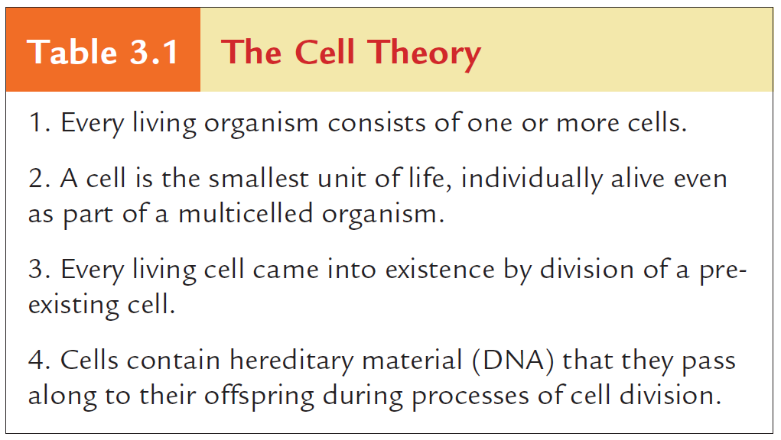

Slide 11
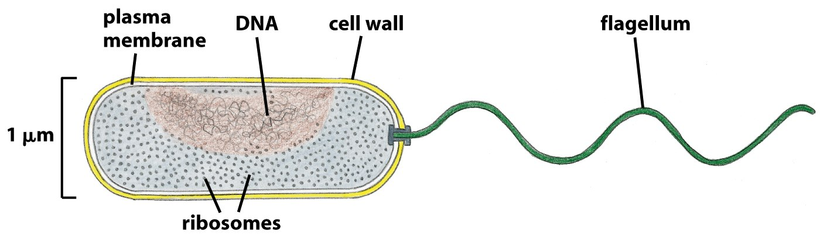
The prokaryotic cells
Of all the types of cells bacteria have the simplest structure and come closest to showing us life stripped down to its essentials. Indeed, a bacterium contains essentially no organelles—not even a nucleus to hold its DNA. This property—the presence or absence of a nucleus—is used as the basis for a simple but fundamental classification of all living things.
Organisms whose cells do not have a nucleus are called prokaryotes (from pro, meaning “before”).
Few microns long.
No nucleus.
No intracellular organelles.
Quick cell duplication.
Single cell organism. Can make colonies.

Slide 12
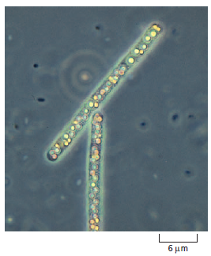
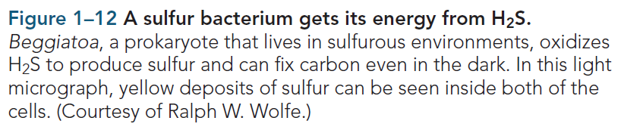
Prokaryotes are the most diverse and numerous cells on earth
Aerobic.
Anaerobic.
some prokaryotes can live entirely on inorganic substances: they can get their carbon from CO₂ in the atmosphere, their nitrogen from atmospheric N2, and their oxygen, hydrogen, sulfur, and phosphorus from air, water, and inorganic minerals.
Photosynthetic.
Chemoautotrophs.
Prokaryotes include bacteria and archaea.
Archaea can live in extreme environments like concentrated brine, the hot acid of volcanic springs, pools beneath the frozen surface of Antarctica, and in the acidic, oxygen-free environment of a cow’s stomach where they break down cellulose and generate methane gas.

Slide 13
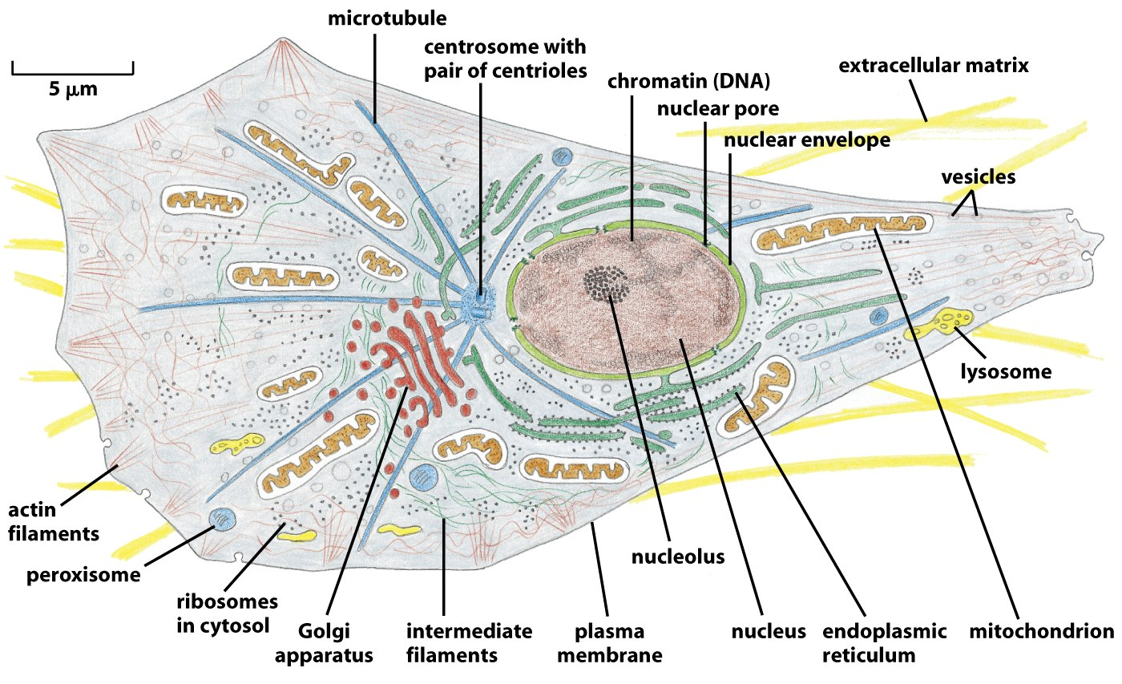
The eukaryotic cells
Eukaryotes (from the Greek words eu, meaning “well” or “truly,” and karyon, a “kernel” or “nucleus”).
Tens of microns long.
Has nucleus.
Diverse types of intracellular organelles (Compartmentalization).
Single celled (amoeba, yeast), or multi cell organisms like plant, animal, human.

Slide 14
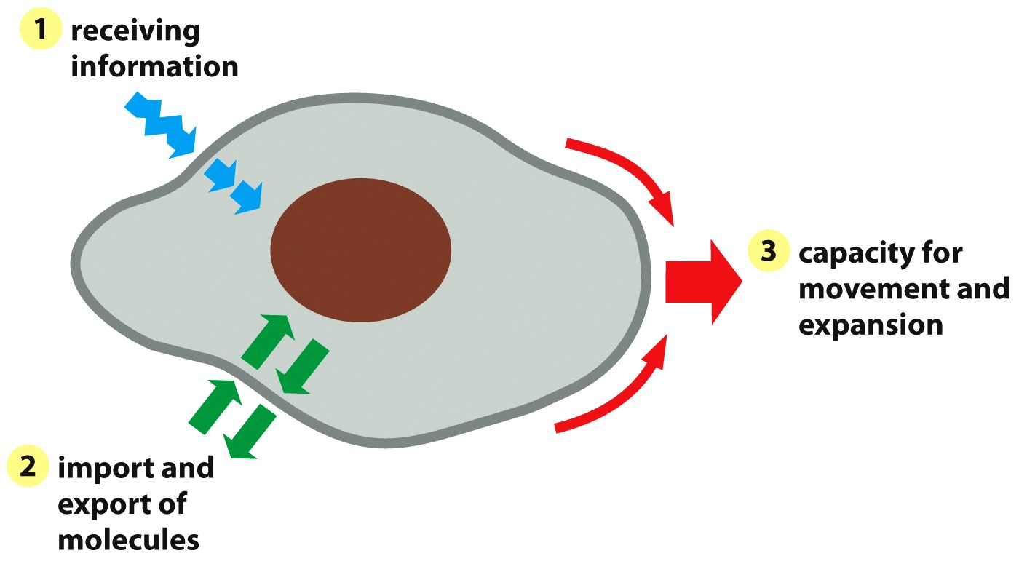
3 important functions of cell membrane
Figure 11-2 Essential Cell Biology (© Garland Science 2010)

Slide 15
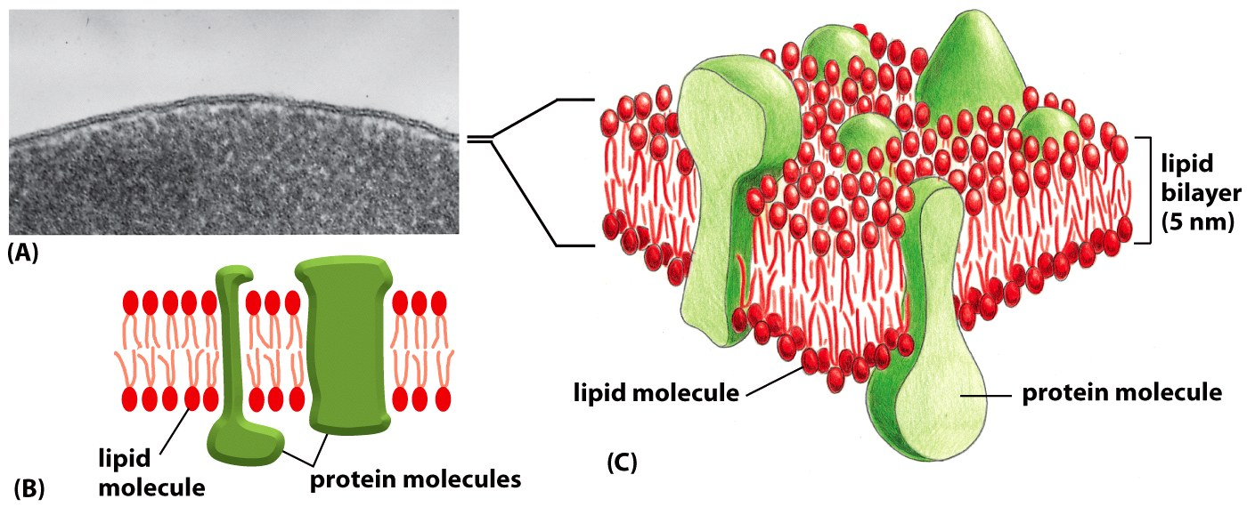
Biomembrane is made up of lipid, protein and small amount of sugar
Sugar molecule
Two molecule thin
The phospholipid bilayer serves as a lipid lake in which a variety of proteins float. This general design is known as the fluid mosaic model.
The carbohydrates associated with membranes are attached either to the lipids or proteins. Carbohydrates are crucial in recognizing specific molecules and to protect from mechanical damage.
Figure 11-4 Essential Cell Biology (© Garland Science 2010)

Slide 16
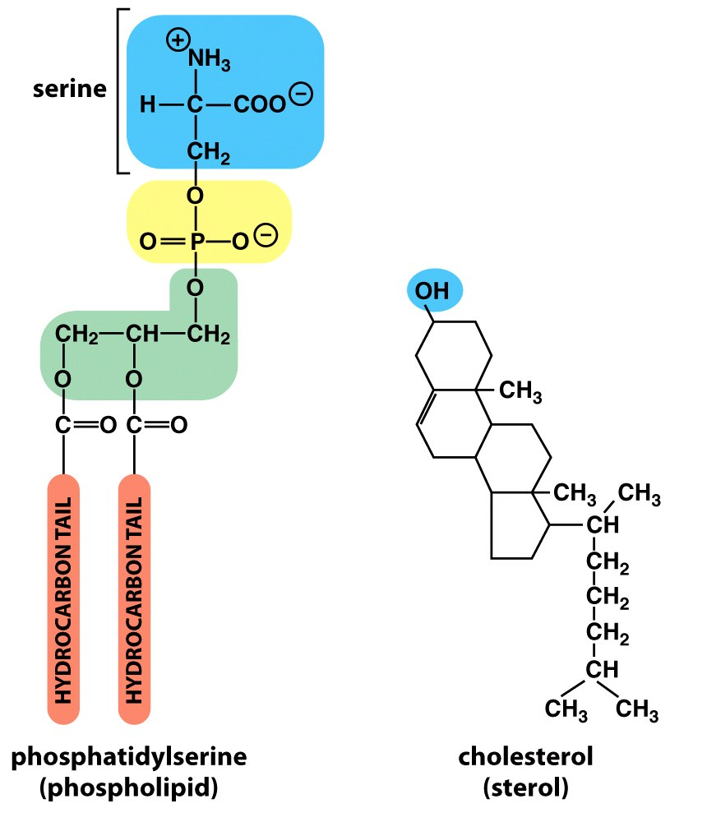
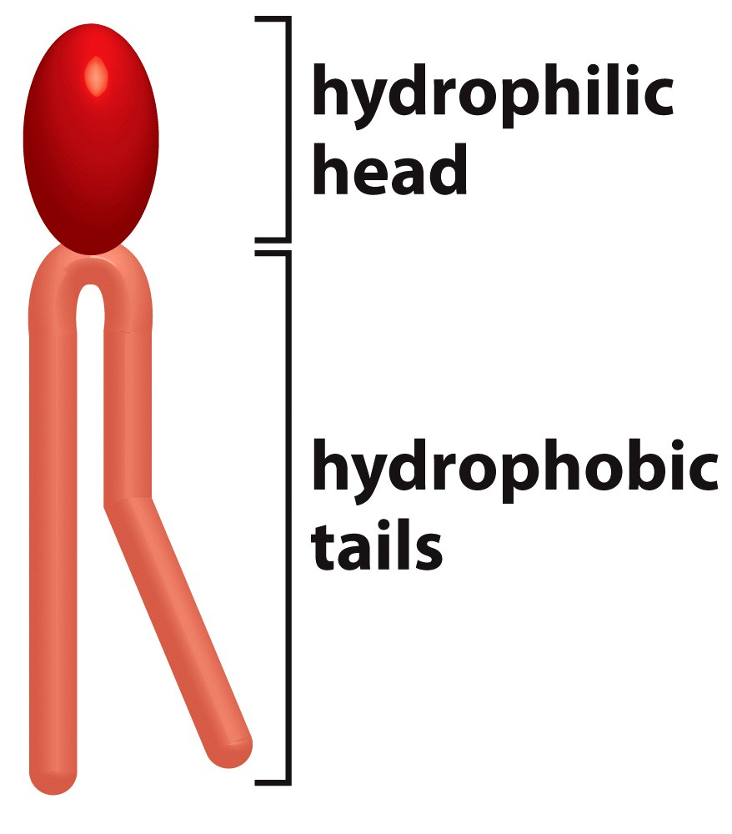
Different types of membrane lipids are all amphipathic
Figure 11-7 Essential Cell Biology (© Garland Science 2010)

Slide 17
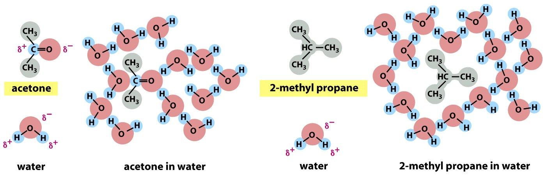
Hydrophilic and hydrophobic interactions
Figure 10-6 Molecular Biology of the Cell (© Garland Science 2008)

Slide 18
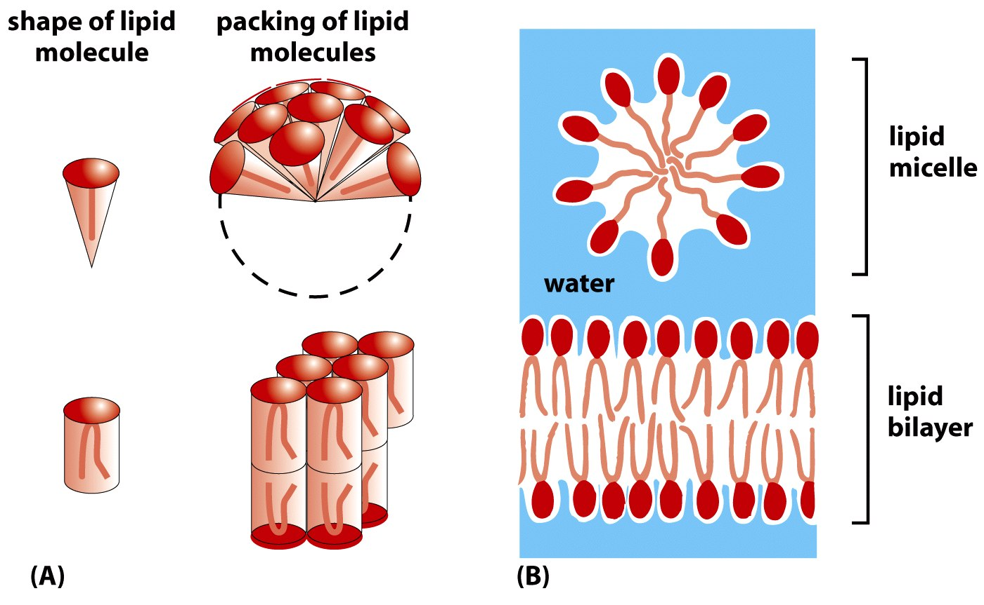
Micelle and bilayer
Figure 10-7 Molecular Biology of the Cell (© Garland Science 2008)

Slide 19
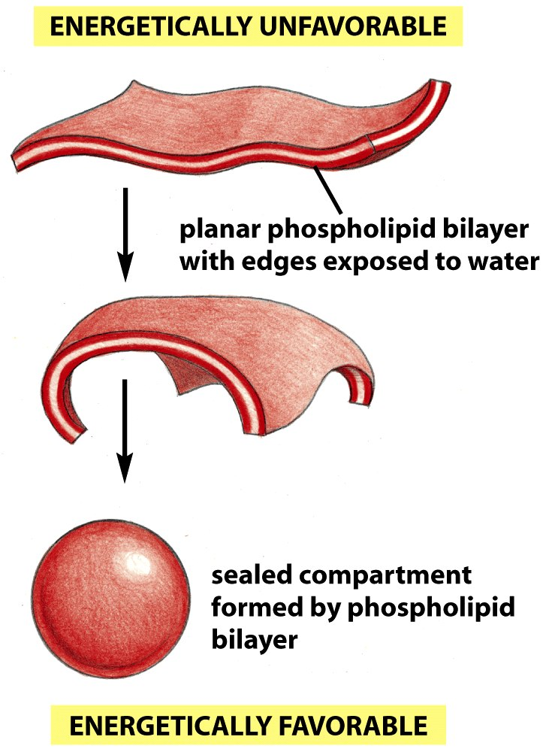
Spontaneous closure of phospholipid bilayer
Figure 10-8 Molecular Biology of the Cell (© Garland Science 2008)

Slide 20
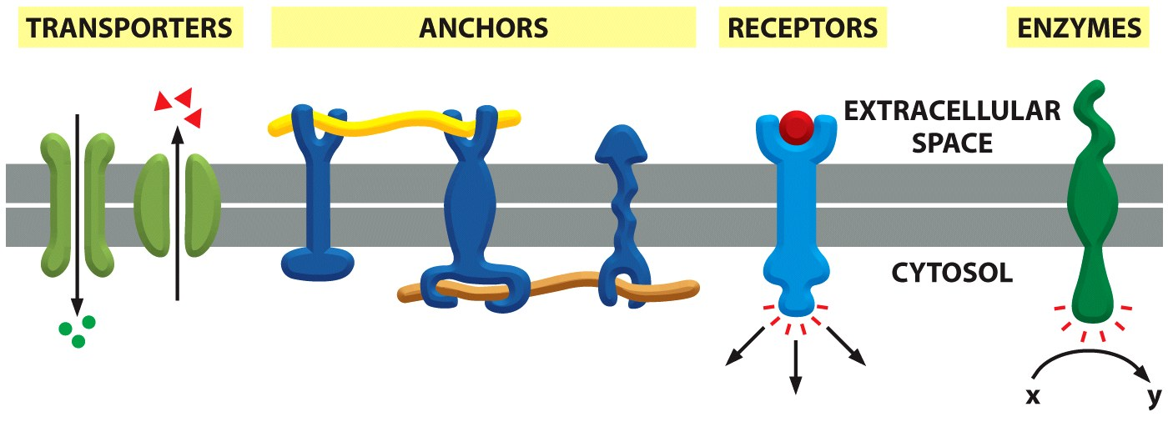
Membrane proteins
30% of protein coding genes code for membrane proteins

Slide 21
Function of membrane Proteins
Adhesion/anchoring protein Membrane protein that helps cells stick together in tissues.
Enzyme Molecule that speeds a chemical process without
being changed by it.
Receptor protein Plasma membrane protein that binds to a
particular substance outside of the cell.
Recognition protein Plasma membrane protein that tags a
cell as belonging to self (one’s own body).
Transport protein Protein that passively or actively assists
specific ions or molecules across a membrane.

Slide 22
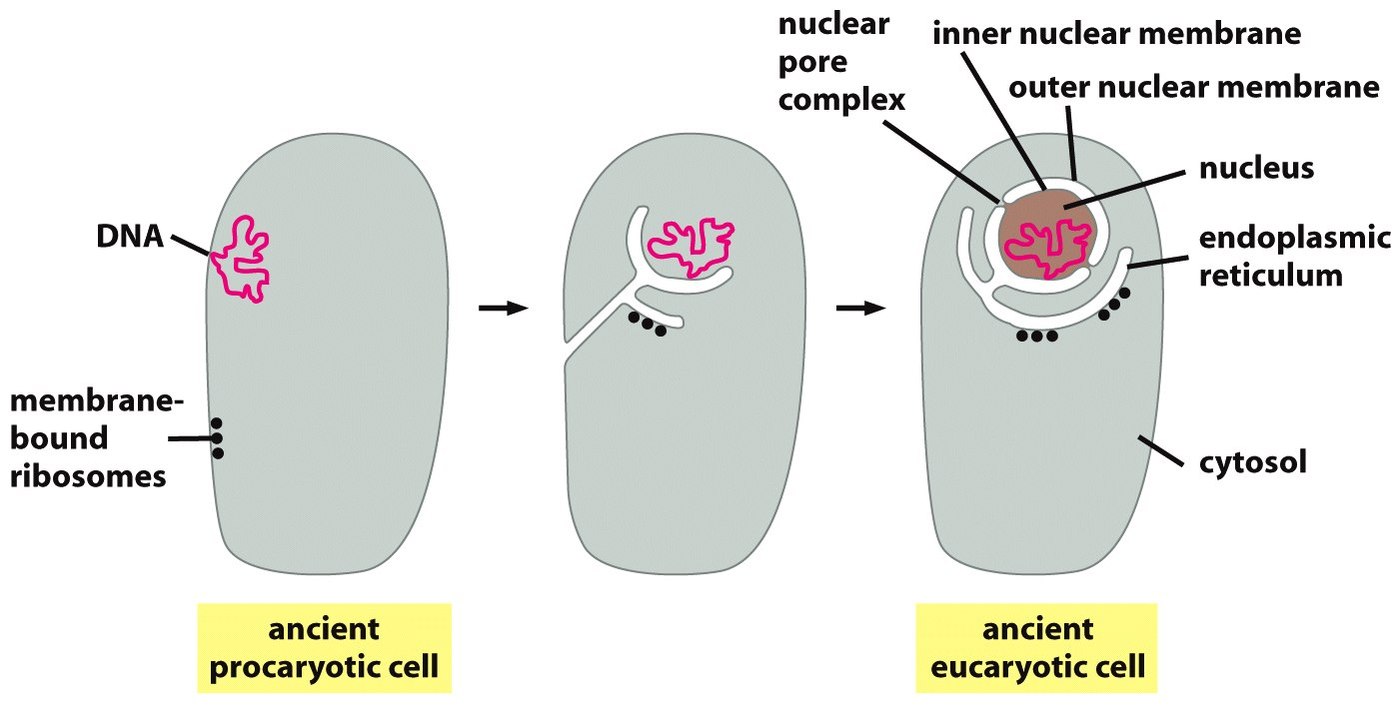
Evolution of nuclear membrane and ER

Slide 23
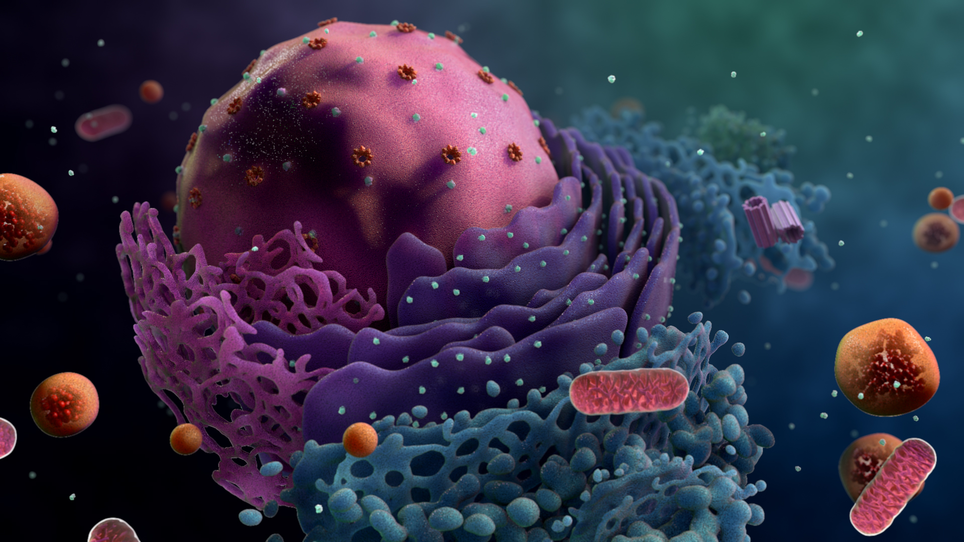
The nucleus
Double membrane compartment
Protects DNA
Isolate DNA from regulators
Living things depend on accurate, appropriate information-to respond appropriately to changing conditions and maintain a constant internal environment. In the cell information is stored in the sequence of nucleotides in DNA molecules. Most of the DNA in eukaryotic cells resides in the nucleus.

Slide 24
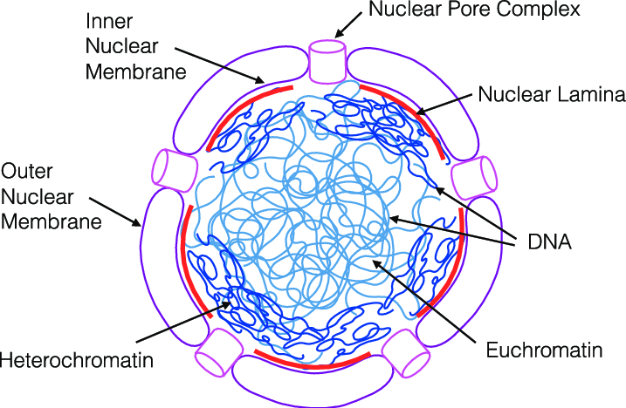
Structure and function of nucleus
Structure:
The single nucleus is usually the largest organelle in a cell.
The nucleus is surrounded by two membranes, which together form the nuclear envelope. The nuclear envelope is continuous with the endoplasmic reticulum.
Nuclear envelop is perforated by nuclear pores which connect the interior of the nucleus with the cytoplasm. RNA and proteins pass through these pores to enter or leave the nucleus.
Inside the nucleus, DNA combines with proteins to form a fibrous complex called chromatin. Chromatin consists of exceedingly long, thin , entangled threads. Prior to cell division, the chromatin aggregates to form discrete, readily visible structures called chromosomes.
Surrounding the chromatin are water and dissolved substances collectively referred to as the nucleoplasm.
Nucleolus
ER
Function:
The nucleus is the site of DNA duplication.
The nucleus is the site of transcription and genetic control of the cell’s activities.
A region within the nucleus, the nucleolus, is the ribosome factory.

Slide 25
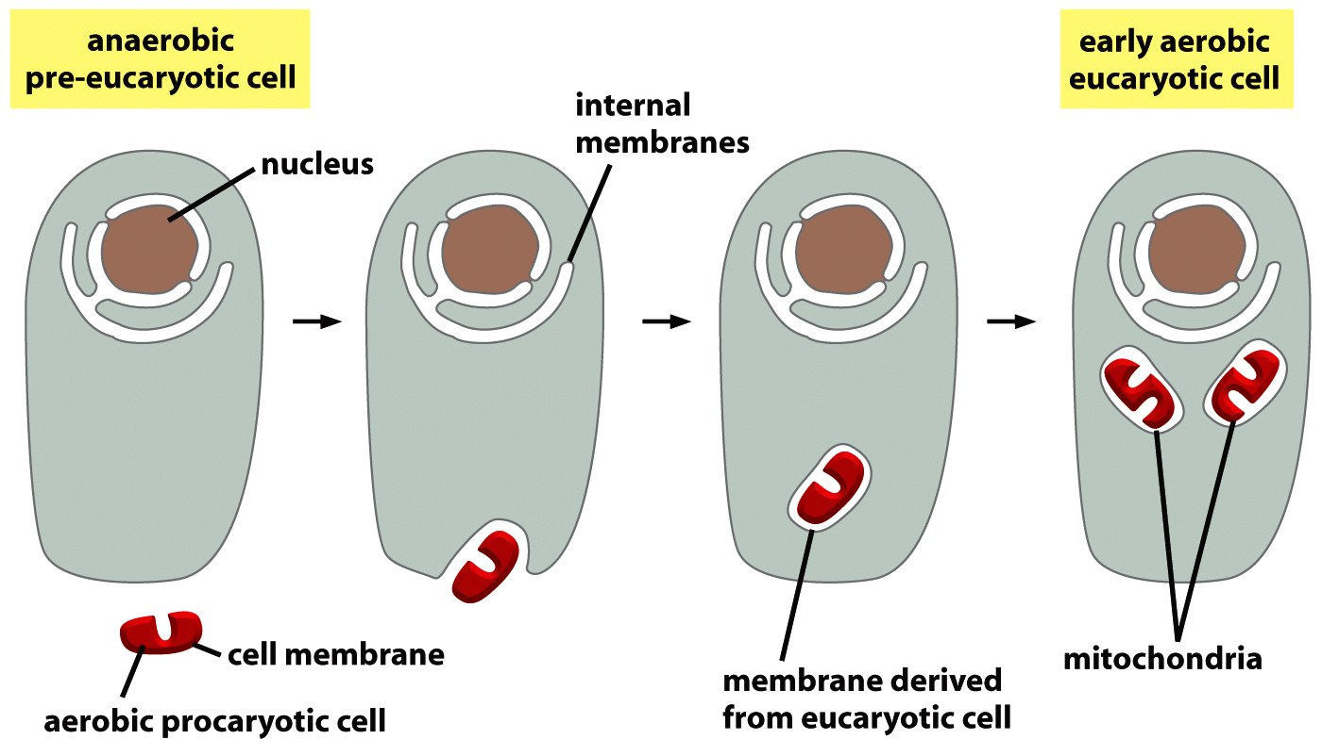
Mitochondria evolved from engulfed bacteria
It is virtually certain that mitochondria originate from bacteria that were engulfed by an ancestral pre-eukaryotic cell and survived inside it, living in symbiosis (endosymbiosis) with their host. Note that the double membrane of present-day mitochondria is thought to have been derived from the plasma membrane and outer membrane of the engulfed bacterium.

Slide 26
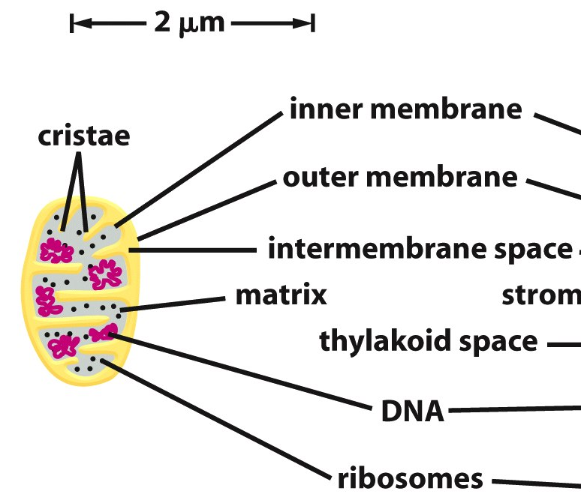
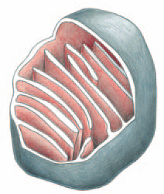
Structure of mitochondria
Mitochondria are membrane-bound organelle found in most eukaryotic cells (the cells that make up plants, animals, fungi, and many other forms of life).
Size of mitochondria is similar to bacterial cells. ~1.0 micrometer (μm) in diameter.
Two membranes. Smooth outer membrane (gray) and the highly convoluted inner membrane (red ).
The inner membrane contains most of the proteins responsible for cellular respiration: one of the mitochondrion’s main functions. Inner membrane is highly folded to provide a large surface area for this activity.
Mitochondria contain their own DNA as mitochondrial genome and reproduce by dividing in two.

Slide 27
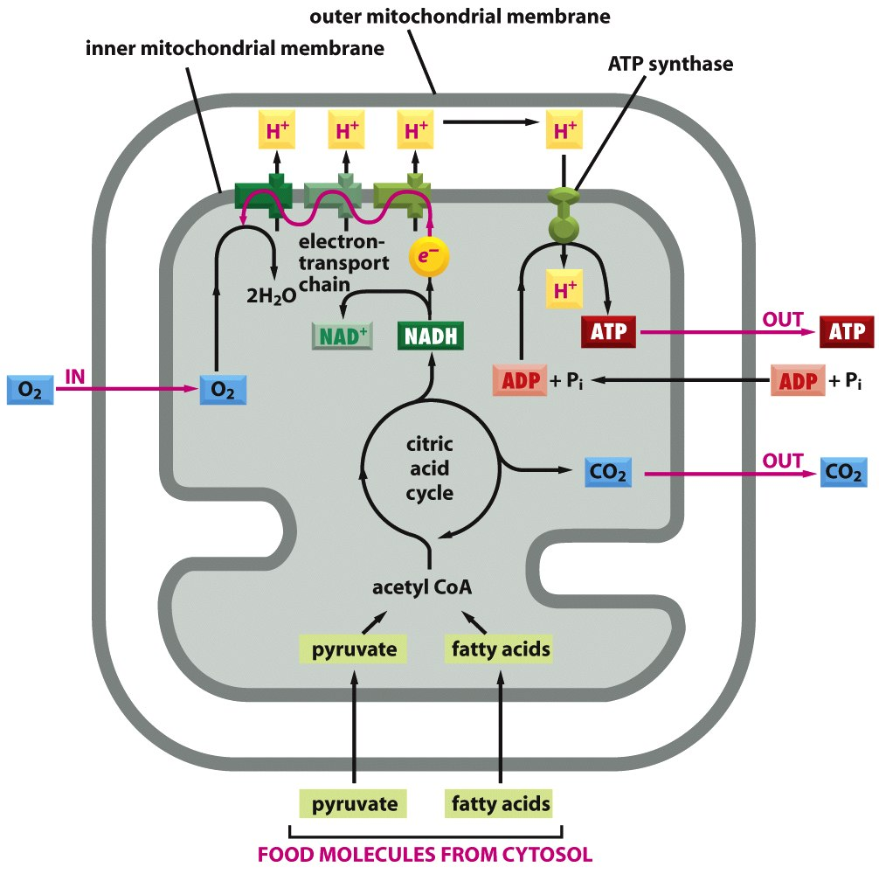
Function of mitochondria
Aerobic respiration

Slide 28
Function of mitochondria
Production of energy currency of the cell, ATP (i.e., phosphorylation of ADP), through respiration. The central set of reactions involved in ATP production are collectively known as the citric acid cycle, or the Krebs Cycle. In these reactions electrons are taken out of bonds of sugar and donated to electron transport chain. Electrons moving through electron transport chain gives away small bits of energy every time it changes hand. Using this energy H⁺ are pumped out of the mitochondrial matrix to intermembrane space generating a high proton gradient across the membrane. When protons allowed to flow down the gradient through a membrane bound enzyme ATP synthase it releases energy which is stored in the bond of newly formed ATP.
Mitochondrion has many other functions in addition to the production of ATP. One of them is regulation of programmed cell death (apoptosis).
Mutation is mitochondrial DNA which harbors many of the respiration related genes many times affect tissues like muscle, brain, neurons which require high amount of energy.

Slide 29
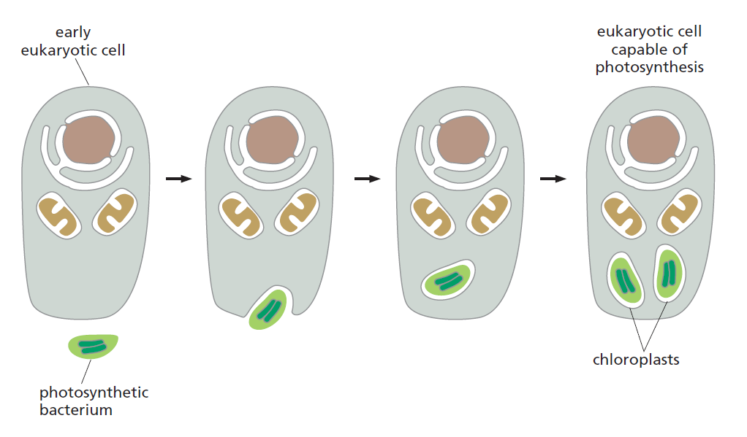
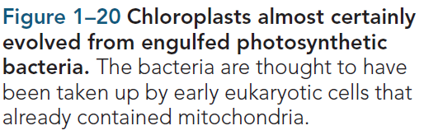
Evolution of photosynthetic eukaryotic cells like algae and plant cells

Slide 30
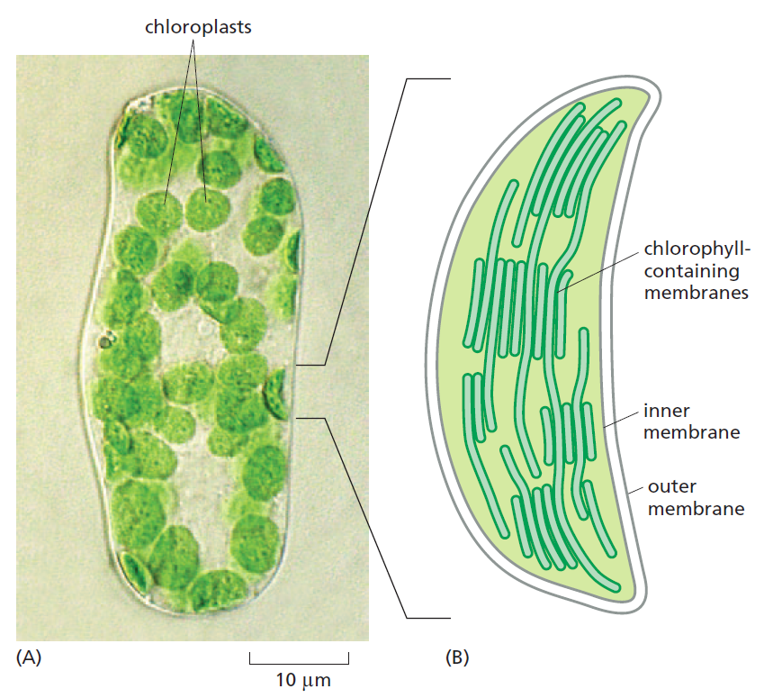
Structure and function of chloroplast
Photosynthetic organelle
Two outer membranes
Photosynthesis takes place at a third, highly folded chlorophyll containing thylakoid membrane inside the stroma
Resemble photosynthetic bacteria
Has own double stranded circular DNA genome and reproduce by dividing in two.
Endosymbiosis
ribosome
stroma
Thylakoid
DNA

Slide 31
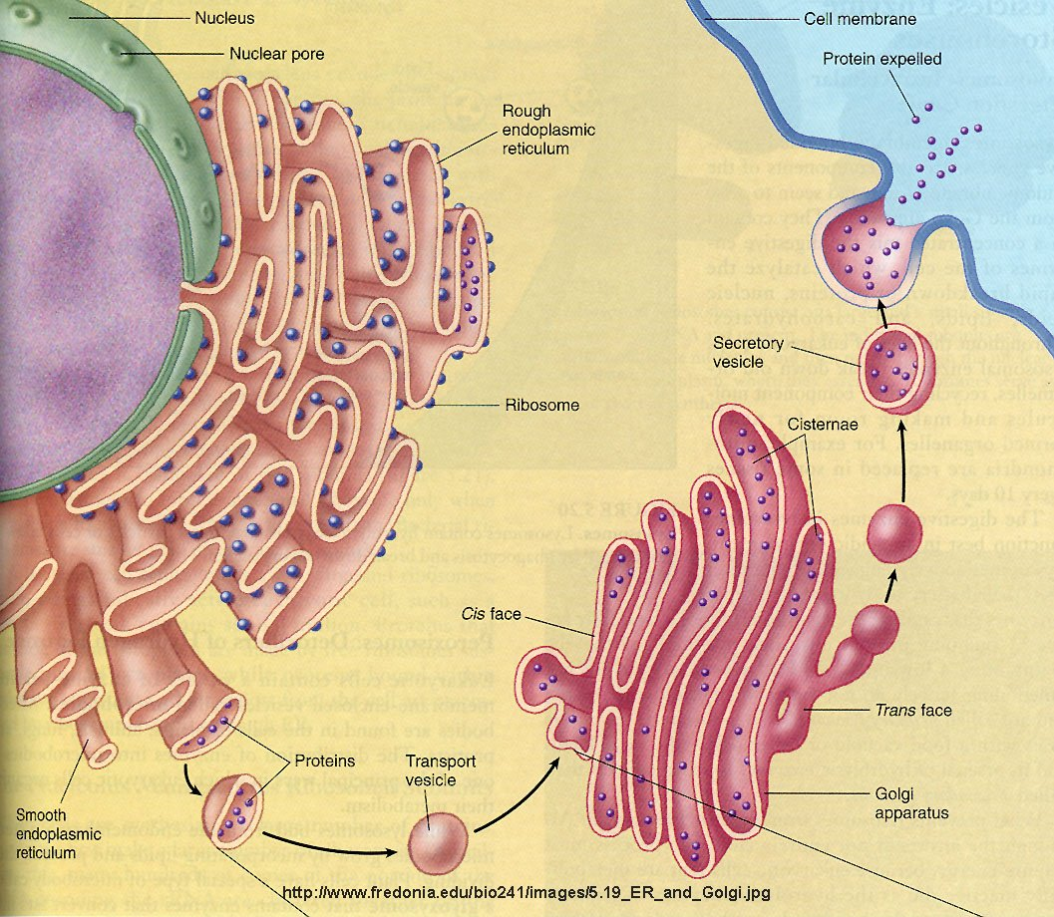
Endomembrane system
ER
Rough
Smooth
Golgi
Cis golgi
Trans golgi
Vesicle
Transport vesicle
Vacuole
Peroxizome
Lysosome
ECB 15.7

Slide 32
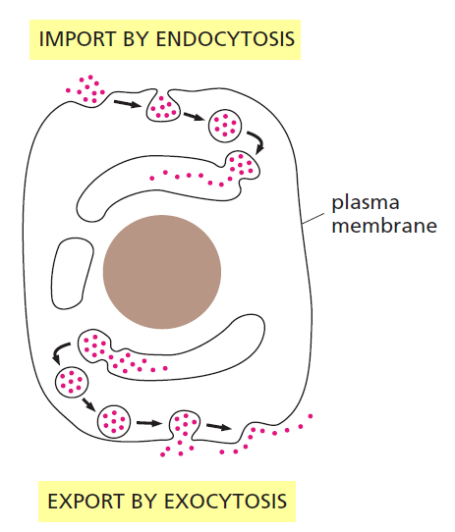
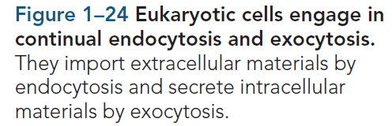
Exocytosis and endocytosis

Slide 33
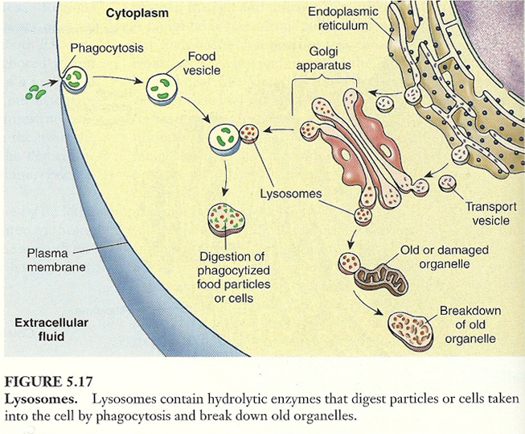
Lysosome : the recycling plant
ECB 15.10

Slide 34
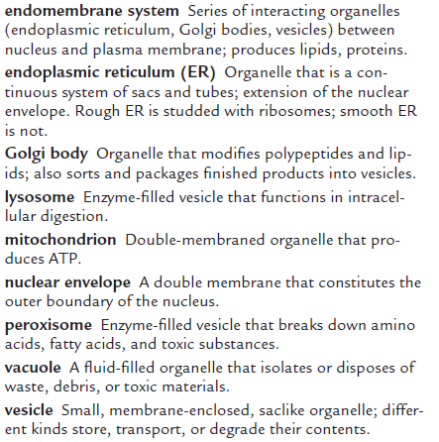
The Cytosol Is a Concentrated Aqueous Gel of Large and Small Molecules
If we were to strip the plasma membrane from a eukaryotic cell and then remove all of its membrane-enclosed organelles, we would be left with the cytosol or cytoplasm. It contains a host of large and small molecules, crowded together so closely that it behaves more like a water-based gel than a liquid solution.
The cytosol is the site of many chemical reactions that are fundamental to the cell’s existence. The early steps in the breakdown of nutrient molecules take place in the cytosol, for example, and it is here that most proteins are made by ribosomes.

Slide 35
Membrane proteins
30% of protein coding genes code for membrane proteins

Slide 36
Function of membrane Proteins
Adhesion/anchoring protein Membrane protein that helps cells stick together in tissues.
Enzyme Molecule that speeds a chemical process without
being changed by it.
Receptor protein Plasma membrane protein that binds to a
particular substance outside of the cell.
Recognition protein Plasma membrane protein that tags a
cell as belonging to self (one’s own body).
Transport protein Protein that passively or actively assists
specific ions or molecules across a membrane.

Slide 37
Evolution of nuclear membrane and ER

Slide 38
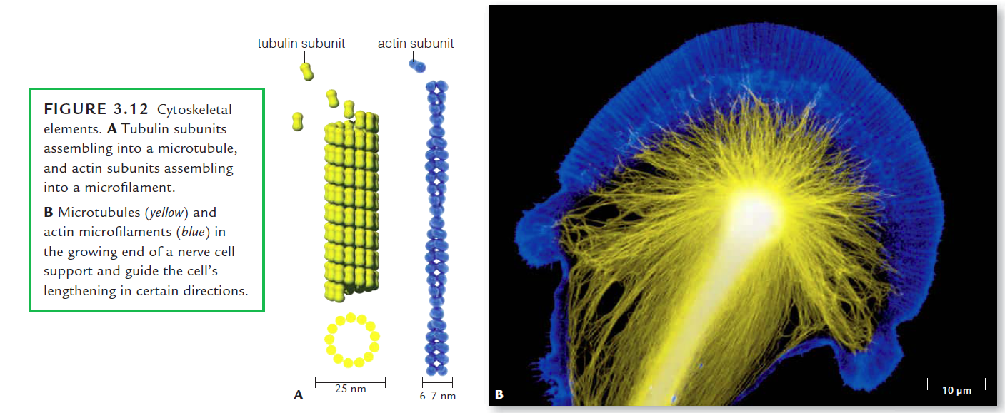
Cytoskeleton : provides frame work and tensile strength to the cell
3 types of cytoskeletal elements:
1. Microfilament/Actin filaments: cell movement, cell shape, cell to cell and cell to substratum adhesion.
2. Microtubule: Intracellular organization, transport of vesicle inside cell, flagellar movement, cell division
3. Intermediate filament: tensile strength to cell, cell to cell and cell to substratum adhesion

Slide 39
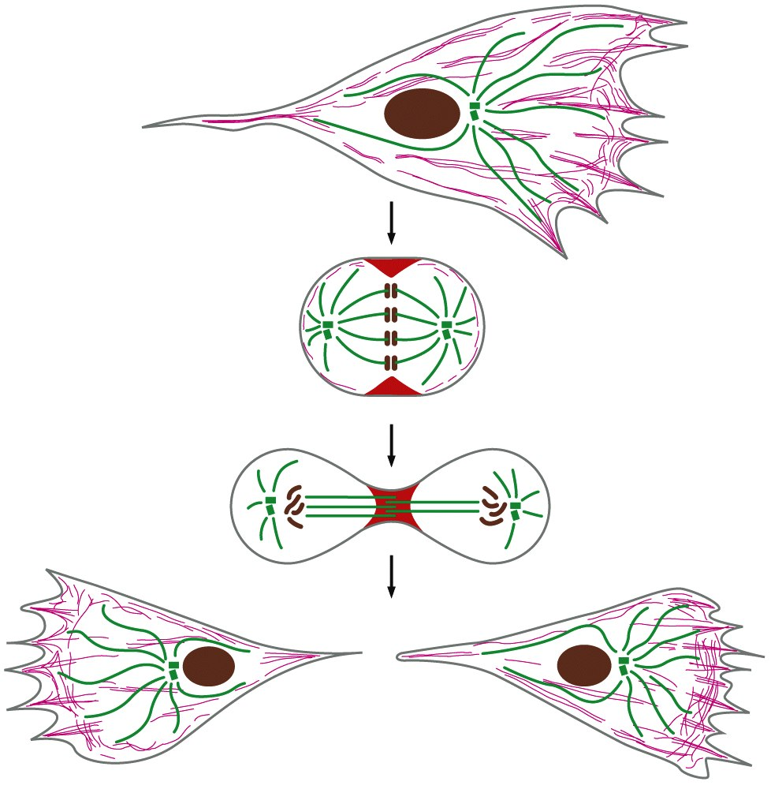
Cytoskeletal filaments are dynamic and adaptive
0 Hr
16 Hr
18 Hr
20 Hr
Figure 17-1 Essential Cell Biology (© Garland Science 2010)

Slide 40
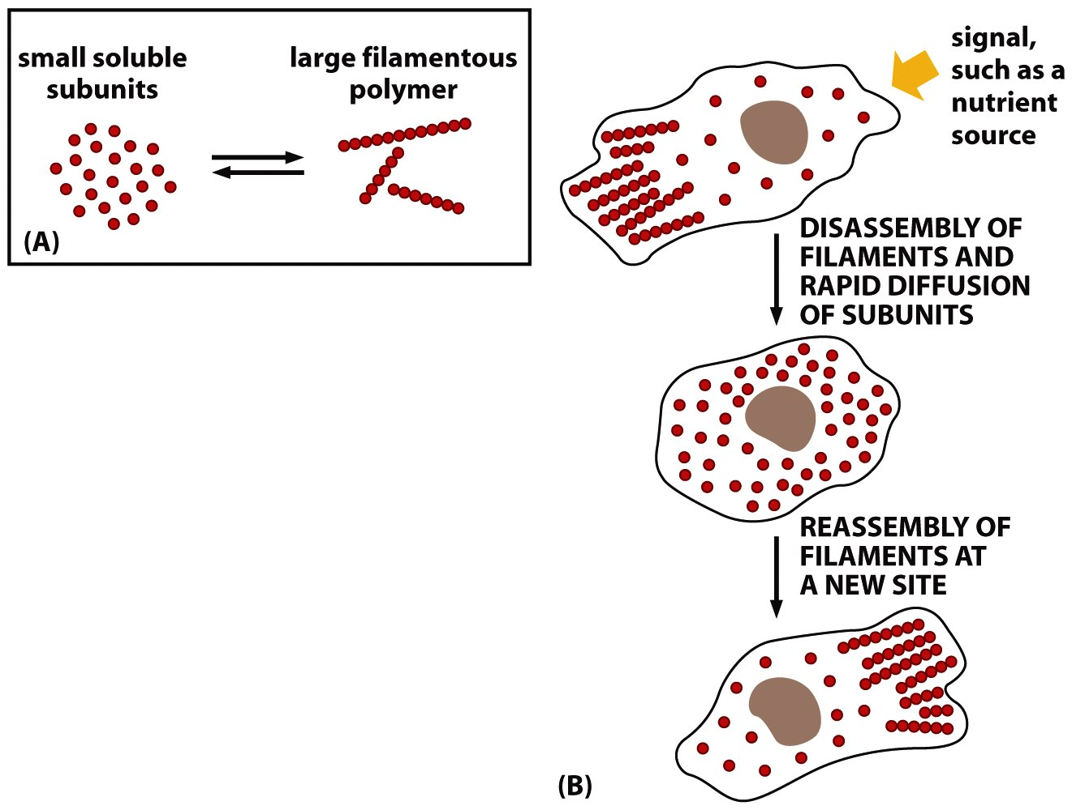
Each type of cytoskeleton filaments are polymeric proteins
Polymeric nature of cytoskeleton makes it easier to disassemble and assemble in seconds
Actin polymerization
ECB 16.8 Neutrophil chase
Figure 17-1 Essential Cell Biology (© Garland Science 2010)

Slide 41
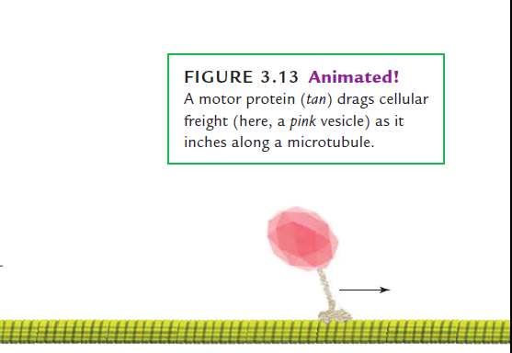
Cytoskeleton acts as rail on which vesicles are transported by motor proteins
(Inside the Brain_ Unraveling the Mystery of Alzheimer’s Disease)

Slide 42
Difference between prokaryotic and eukaryotic cells
Prokaryotes | Eukaryotes
Appeared first 3.8 billion years ago | Appeared first 1.2 billion years ago
Size usually 1–2 μm | Usually 5–100 μm
Nucleus is absent | Nucleus is present, bounded by nuclear envelope.
No internal compartmentalization | Well defines internal compartments like nucleus, ER, Golgi, mitochondria, chloroplast, lysosome etc.
Do not make multicellular organism. | Can make multicellular organisms.
Ribosomes 70S | Ribosomes 80S (mitochondria and chloroplast ribosomes are 70S)
Cytoskeleton is absent | Microtubules, microfilaments, and intermediate filaments make well organized cytoskeleton.

Slide 43
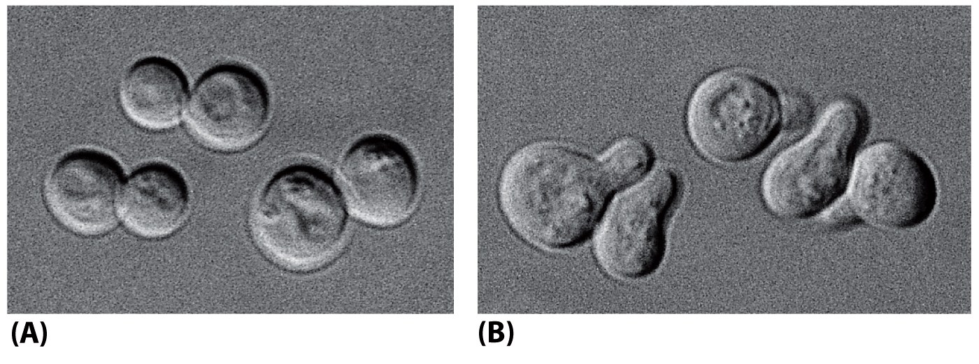
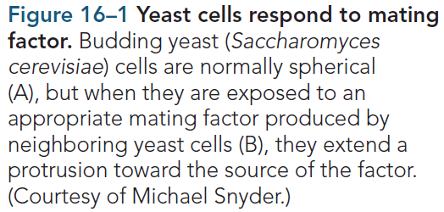
Cells have to sense and respond to its environment
Figure 16-1 Essential Cell Biology (© Garland Science 2010)

Slide 44


Signal transduction
Signaling could alter the target cell’s shape, movement, metabolism, or gene expression, or some combination of these.
Figure 16-2 Essential Cell Biology (© Garland Science 2010)

Slide 45


Slide 46


Four ways of signaling in multicellular animals
The signal molecules can be proteins, peptides, amino acids, nucleotides, steroids, fatty acid derivatives, or even dissolved gases—but they all rely on only a handful of basic styles of communication for getting the message across.
Long or short distance
Private or public
/ NEUROCRINE
/ PARACRINE
/ JUXTRACRINE

Slide 47
Each cell responds to a limited set of signals
Based on:
What receptors it is expressing
What intracellular signaling molecules it is expressing
What effector proteins it is expressing
Each receptor binds to a very specific extracellular signaling molecule, but same signaling molecule can bind to different receptors
Figure 16-5 Essential Cell Biology (© Garland Science 2010)

Slide 48

Same signaling molecule can induce different response in different target cells
Various responses induced by the same neurotransmitter acetylcholine. Different cell types are specialized to respond to acetylcholine in different ways. In some cases (A and C), the receptors for acetylcholine differ. In other cases (A and B), acetylcholine binds to similar receptor proteins, but the intracellular signals produced are interpreted differently in cells specialized for different functions due to different effector proteins.
Figure 16-5 Essential Cell Biology (© Garland Science 2010)

Slide 49


An animal cell depends on multiple extracellular signals which can interact with each other

Slide 50

Two classes of extracellular signaling molecules
Figure 16-8 Essential Cell Biology (© Garland Science 2010)

Slide 51

Cell’s response to a signal can be fast or slow
Figure 16-7 Essential Cell Biology (© Garland Science 2010)

Slide 52

Steroid hormones have cytosolic or nuclear receptor which acts as transcriptional regulator

Slide 53


Intracellular signaling pathways relay signal from cell surface receptors

Slide 54


Intracellular signaling pathways can relay, amplify, integrate and distribute signals

Slide 55


Different types of signaling events at the cell surface

Slide 56

Signaling is done through molecular switches
https://www.youtube.com/watch?v=xG2WOd_fWqo
Figure 16-14 Essential Cell Biology (© Garland Science 2010)

Slide 57

Many times final response of a cell comes after integrating multiple signals
Cell response
Figure 16-43 Essential Cell Biology (© Garland Science 2010)

